Slide 1
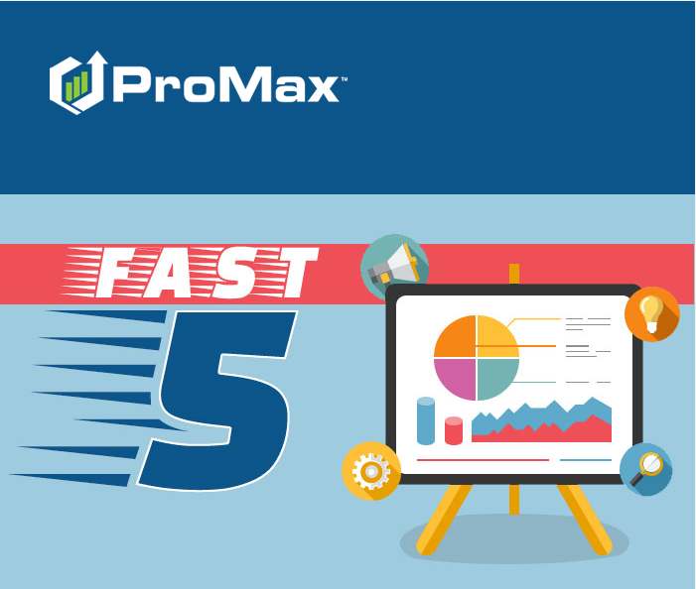
February

Slide 2
Agenda
Dropping a Co App
Requesting a New Email Address
Stack – Data Core
Stack – New Labels
Creating/Requesting New Lead Sources

Slide 3
Stack – New Labels
We recently made some changes to our labels. We are hoping that these changes make navigating the system a little easier for new users.

Slide 4
Before: ProMax (logo)
After: Stack (logo)

Slide 5
Before: Recall
After: Search

Slide 6
Before: Appointments
After: Appt Log

Slide 7
Before: Sales Rep (on Appt Log)
After: Appt Set For

Slide 8
Before: Service (on Appt Log)
After: Service Appt Log

Slide 9
Before: Compliance (on Dashboard)
After: Compliance Review

Slide 10
Before: Flexible Desking
After: Deal Structure

Slide 11
Before: Print Deal
Before: Enter Showroom Visit
Before: Credit Review & Lender Selection
Before: Submit this Deal
Before: Best Call Back
After: Print Screen
After: Create Visit
After: Submit Deal
After: Submit Deal
After: F&I Log

Slide 12
Before: New Cust Workscreen
Before: New Credit App
Before: Prospect Logs
Before: Incoming Call
After: Enter Customer
After: Enter Credit App
After: Customer Lists
After: Incoming Phone Script

Slide 13
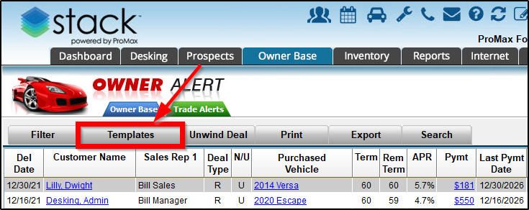
Before: Communications
After: Templates

Slide 14
Before: Unwind (in OwnerBase)
After: Unwind Deal

Slide 15
Before: Edit Vehicle
Before: Recall
After: Search Inventory
After: Search

Slide 16
Before: Browse Inventory
After: Inventory Reports

Slide 17
Before: Prospect Activity Report
Before: Salesperson Tracking Report
Before: Finance Profit Summary Report
Before: Sold Vehicle/Profit Report
After: Prospect Activity Report Builder
After: Salesperson Tracking Report Builder
After: Finance Profit Summary Report Builder
After: Sold Vehicle/Profit Report Builder

Slide 18
Before: BDC and Sales Management Report
After: Lead Mgmt and Results

Slide 19
Before: BDC and Sales Management
After: Lead Mgmt and Results

Slide 20
Before: Dealership Settings
Before: BDC Settings
Before: Automated Follow-Up
Before: Broadcast E-Mail
Before: Std. Fees
Before: Desking
Before: Buy-Lease Proposal
After: Dealership Setup
After: General Settings
After: Automated Follow Up
After: Autoresponder
After: Standard Fees
After: Desking Settings
After: Proposal Settings

Slide 21
Before: User Templates (in User Access)
After: Apply User Template

Slide 22
Before: Appointments (on Service Dashboard)
Before: Compile Report
After: Appt Log
After: Compile

Slide 23
Before: Docs (on Customer Workscreen)
Before: Deals
Before: Review & Submit
Before: Communications
After: Stored Docs
After: Saved Deals
After: Submit Deal
After: Templates

Slide 24
Before: Review and Submit (on Credit App)
Before: Stored Deals
Before: Applicant Information
Before: Residence Information - Current
After: Submit Deal
After: Saved Deals
After: Applicant Info
After: Current Residence Info

Slide 25
Stack – Data Core

Slide 26
There is no other software company in our industry the has a data set like ours. Especially with credit integrated directly into the platform.

Slide 27
Stack, powered by ProMax is a fully integrated, all in one platform. When we combine all these attributes together, we are able to give dealerships a holistic view of each customer’s journey and their current position.

Slide 28
Dropping a Co App

Slide 29
Dropping a Co App
If you have customers that are already linked as app and co app, you change this if needed.
Credit App > Co App > Drop Co App > Send Co App to the Prospect Log

Slide 30
Creating/Requesting New Lead Sources

Slide 31
New Lead Sources
Whenever you sign up for a new lead provider you will need to let us know so that we can make sure it is set up to import for you.
The new lead provider will also want to know your lead importing address. This is the email address associated with the user “Imported Leads” in your User List.
The standard lead format is ADF/XML.
We generally request that a test lead be sent first in order to confirm that it is importing the way you would like.
In general, a lead should only take a minute or two to import. Any longer – let us know and we can look into it for you.

Slide 32
New Lead Sources
Here are the steps to add a new lead source or request us to add a new lead importing source:
Admin > Lead Sources > Request New Lead Source > Fill out required info > Send

Slide 33
Requesting a new Email Address

Slide 34
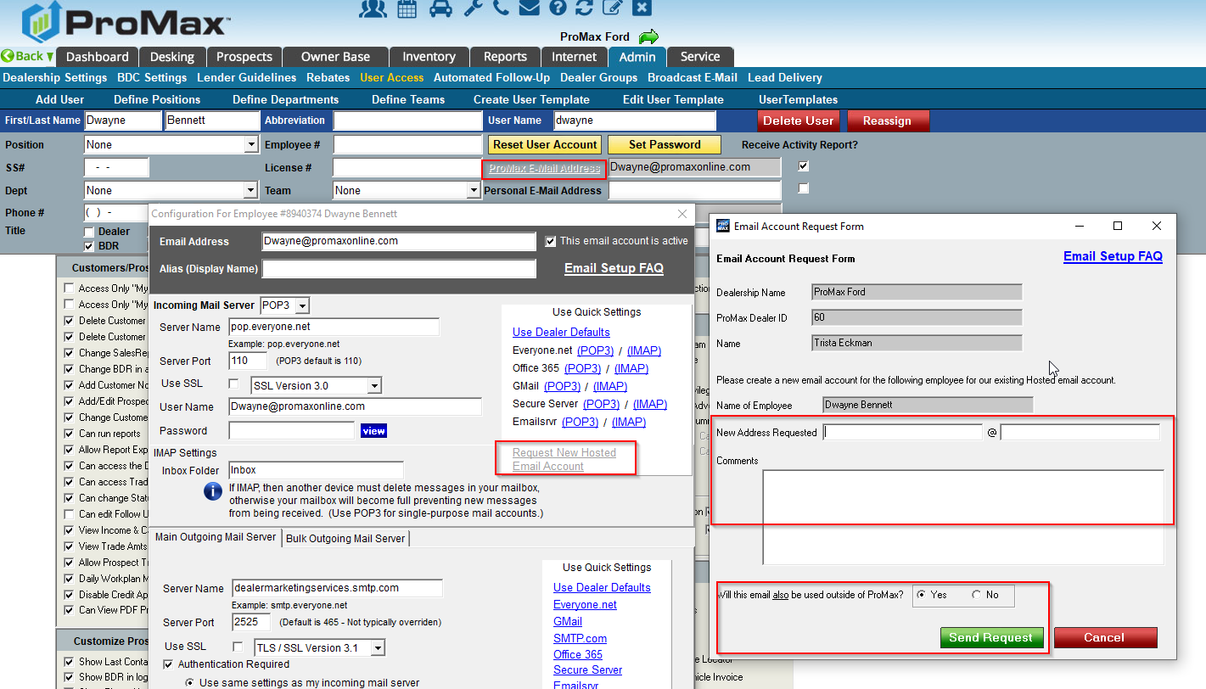
New Email Address
In ProMax, you can either enter your own email credentials into the system to use, or use email addresses hosted by us.
When you use emails hosted by us we take care of all of the administrative tasks that go along with that like set up, testing, and trouble shooting.
When you have a new person that needs an email created you have to let us know. To do this, hit the “Request new hosted email” link in Admin > User Access> User’s Name > ProMax Email Address.

Slide 35
Questions?
Contact our Dealer Support Line at 844-322-9034
Contact me directly at 563-344-7618 or Trista@ProMaxUnlimited.com
PromaxUnlimited.com
Facebook.com/ProMaxUnlimited
Twitter.com/ProMaxUnlimited
LinkedIn.com/Company/ProMax-Automotive-Software/
DealerUpdates.TypePad.com/Blog/

